Slide 1
CO656 Optimising trading strategies with technical analysis
Jungmoo Lee (jl749)

Slide 2
Introduction
In this assignment I forecast future stock price using 4 technical signals.
-Moving Average (MA)
-Trade Break out Rule (TBR)
-Volatility (VOL)
-Momentum (MOM)
Goal is to make good forecast model that can maximize profit using GA

Slide 3
Individual representation
Instances that have the same pattern of signals are likely to have same/similar features or properties on the graph.
<Example>
 | Signal 1 | Signal 2 | Signal 3 | Signal 4
Instance A | 1 (Buy) | 1 (Buy) | 2 (Sell) | 0 (Hold)
Instance B | 1 (Buy) | 1 (Buy) | 2 (Sell) | 0 (Hold)

Slide 4
Using this assumption…..
Create individuals in 2D array
Containing:
→ All possible patterns of signals (0000, 0001, 0002, 0010, 0011….. 2222)
→ Weight Set corresponding to each pattern
* Weight Set selected depending on its signals

Slide 5
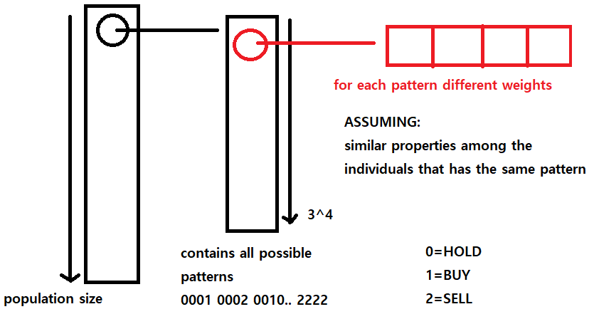

Slide 6
Fitness Function
Using the Weight Set, Decide which action to perform.
0.4 x Signal 1 => BUY
0.2 x Signal 2 => BUY
0.1 x Signal 3 => HOLD
0.8 x Signal 4=> SELL
Buy = 0.6
Sell = 0.8
Hold = 0.1
SELL
Calculate Fitness using initial 3000 budget.
Buy 1 share every BUY signal and sell 1 share on every SELL signal. (HOLD do nothing)

Slide 7
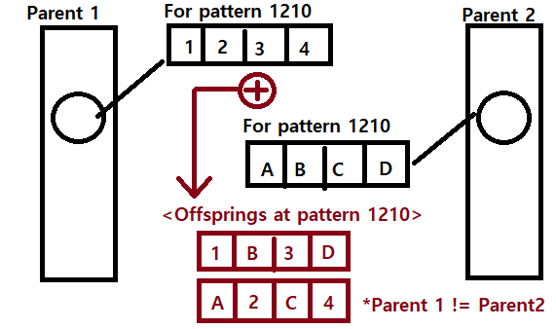
Selection Method / Genetic Operator
- Tournament selection for Selection Method (Arena size = 20% of Population Size)
- Use CrossOver and Mutation method as Genetic Operators.
*Crossover should not work on the same population index (2 different population indexes)

Slide 8
Mutation Method
Mutation performs its own selection method. (roulette selection)
*Frequently used genes (Essential for individual’s survival) are more likely to be conserved.
*Infrequent genes are more likely to mutate.
Selection chance = (log10 (PATTERN_FREQUENCY) + 1) / Total_Frequency
* Total_Frequency = ∑ 1 / (log10 (Frequency i) + 1)
e.g) Pattern 2101 has appeared 100 times over the dataset, Total_Frequency = 15.003
→ (1 / (log10 (100) + 1) ) / 15.003 = 2.2%
Use logarithmic scale to normalise frequencies
n
i=0
Pattern 2101 has 2.2% chance of mutating

Slide 9
Test Results
Ran 5 tests using following thresholds
Mutation_Rate = 0.1
Population_Size = 1000
Max_Gen = 200
Higher population will cause higher chance of individual improving over the generations.

Slide 10
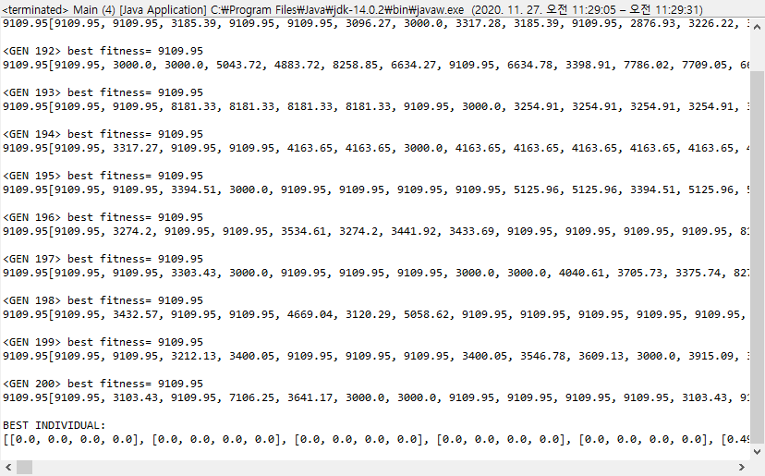

Slide 11
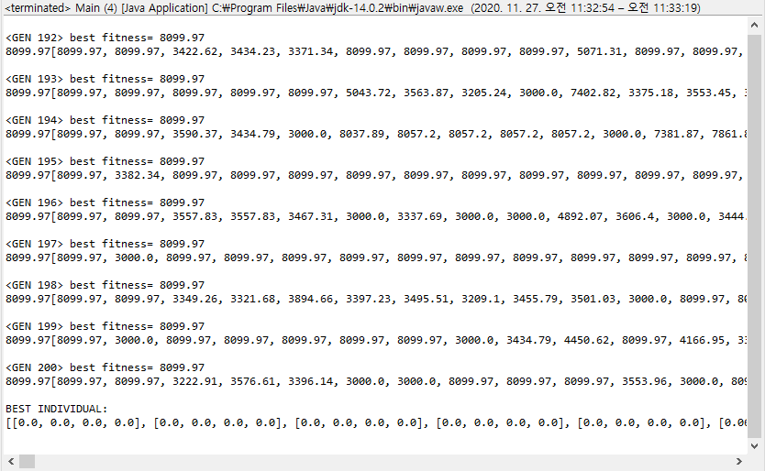

Slide 12
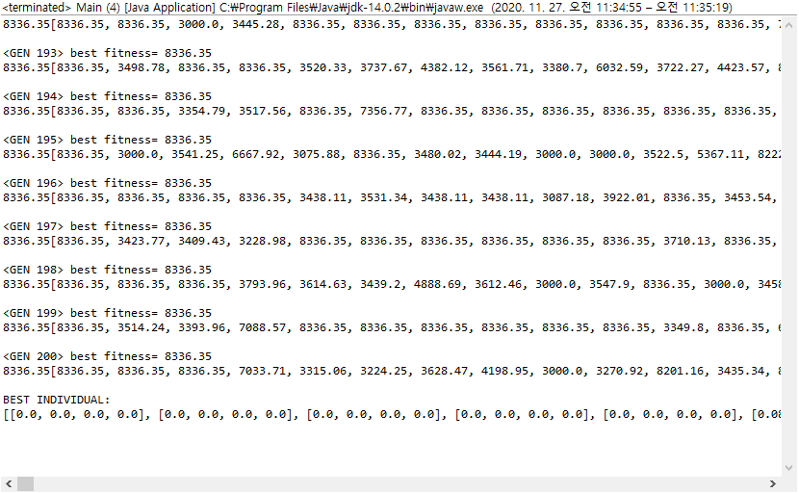

Slide 13
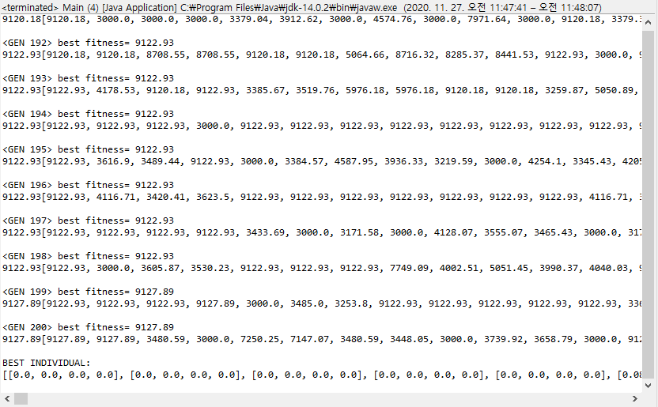

Slide 14
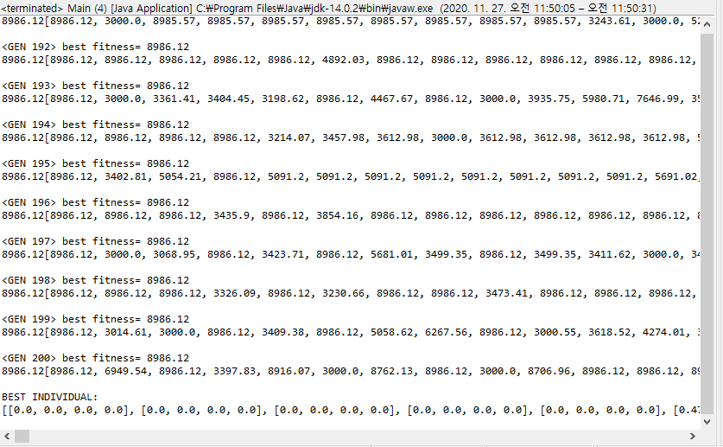

Slide 15
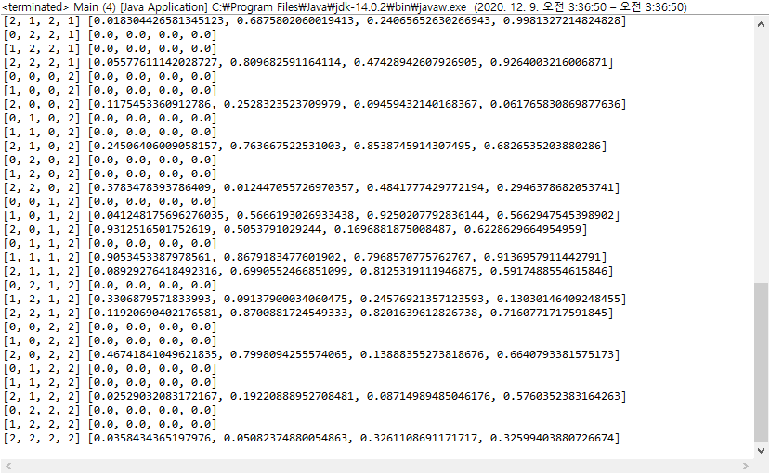
Using Decoder
Simple static function in Main class that decodes individual representations and prints out in human readable form.
[[0.0, 0.0, 0.0, 0.0], ……...[0.98, 0.31, 0.21, 0.27], [0.12, 0.54, 0.42, 0.65] ,[0.0 ,0.0, 0.0, 0.0]]
Corresponding weights (0~1)
[0, 0, 0, 0] indicates pattern hasn’t appeared throughout the test dataset
Signal patterns [MA, TBR, VOL, MOM]

Slide 17
Benefits of using my own Implementation
Using just one set of weights for individual representation has resulted around 5k output. (Under the same thresholds)
Implementing my solution, output has dramatically improved. (Now around 7~9k)
Using my representation, users can define which weight set can perform the best for every scenario.

Slide 18
Drawbacks that can be caused by my representation
It is a complex design. (take long computational time)
→ MY_SOLUTION
It reduces the computational time significantly
When initialising or applying genetic operators, Do not consider the patterns that have 0 frequency (not occurred throughout the test dataset)
These pattern indexes don’t worth considering since there are no records that GA can study.

Slide 19
What went Well / Wrong
Difficulties I faced
Modifying genetic operators to work on my individual representations.
Potential calculation error using Math.log function. (rounded error to solve)
Random isn’t really random. (tried using currentTimeMillis as seed)
What went well
My individual representation was successful
My mutation method worked well (better solutions over the gen)

Slide 20
What I would do differently next time
I believe my fitness function is not reliable. (Buy 1 , Sell 1 strategy)
Hence, next time I will make it to take actions only when the same results (BUY/SELL/HOLD) occur over N times.
e.g) Buy when 3 Buy signals occur in series

Slide 21
Tweaking Thresholds (1)
Using
Mutation_Rate = 0.5
Population_Size = 1000
Max_Gen = 200

Slide 22
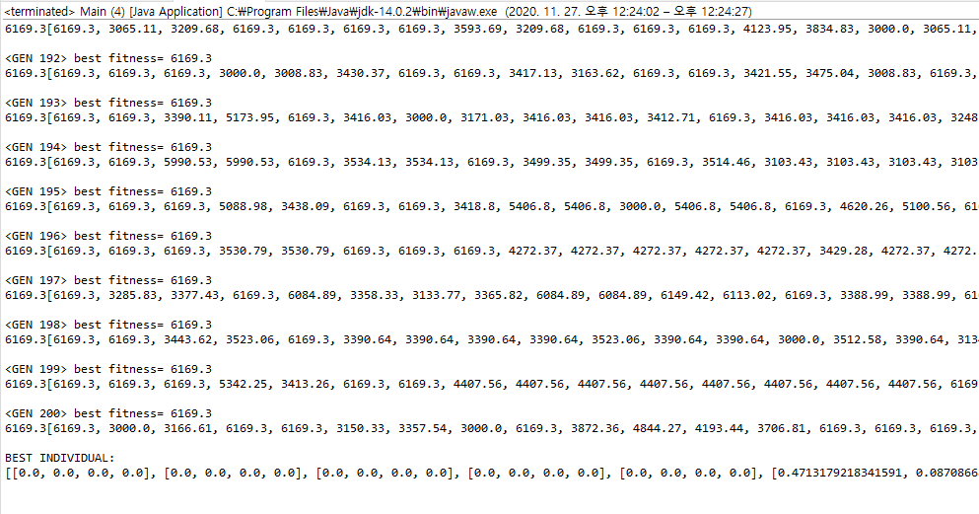

Slide 23
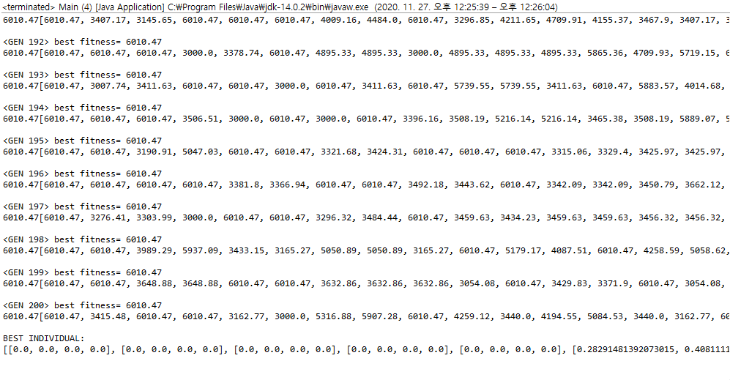

Slide 24
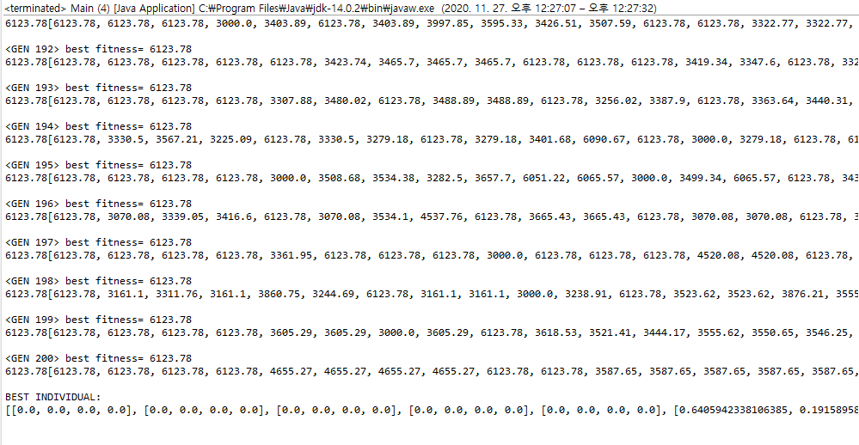

Slide 25
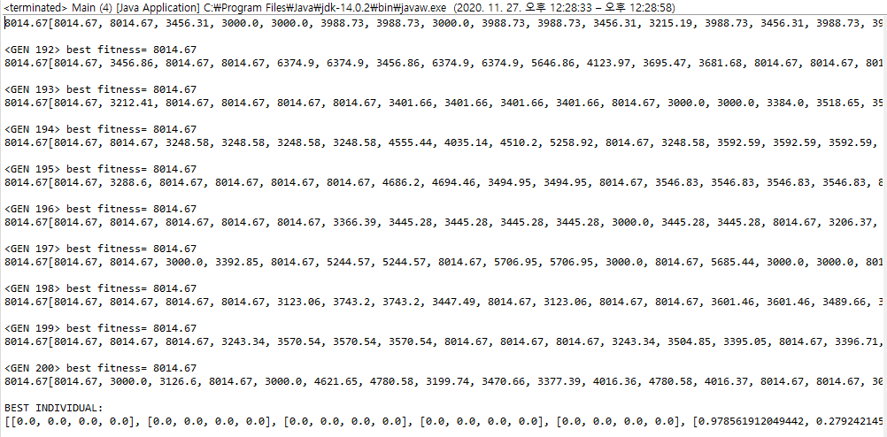

Slide 26
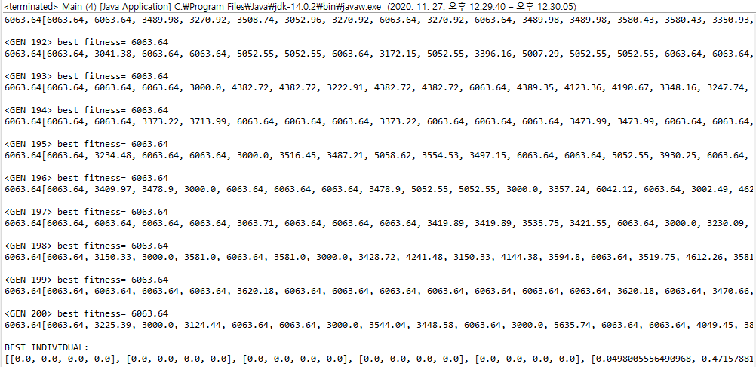

Slide 27
Tweaking Thresholds (2)
Using
Mutation_Rate = 0.0
Population_Size = 1000
Max_Gen = 200

Slide 28
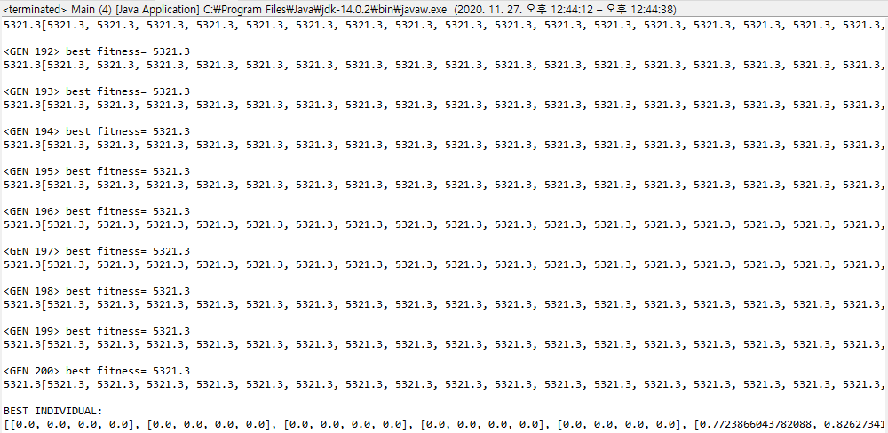

Slide 29
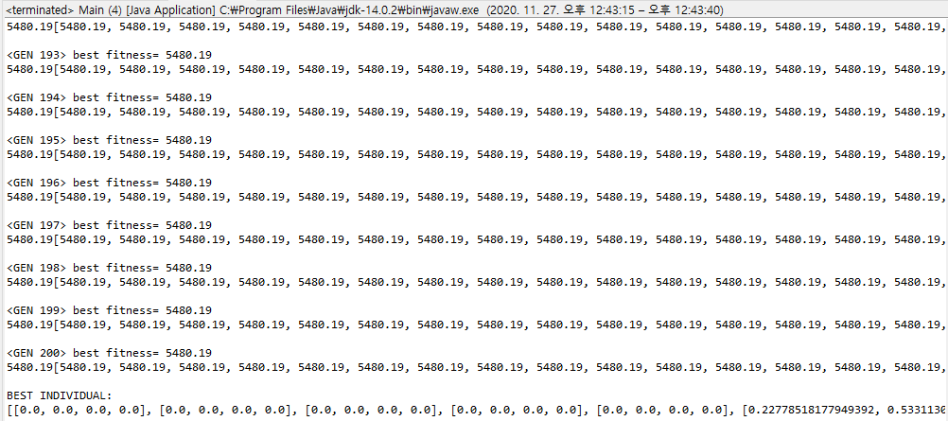

Slide 30
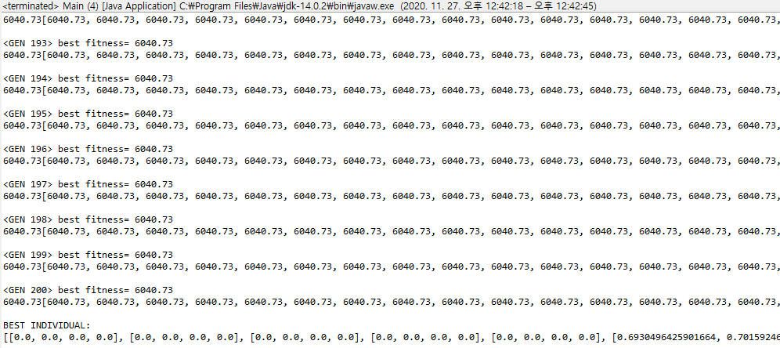

Slide 31


Slide 32
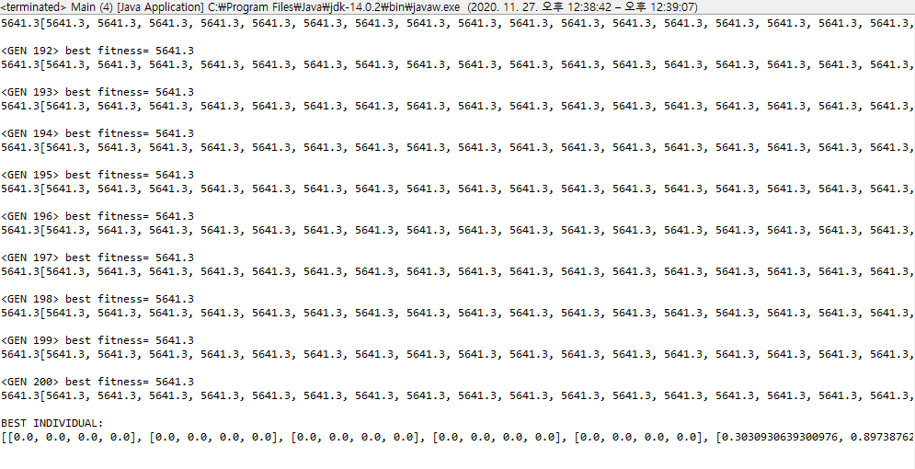

Slide 33
Conclusion
If mutation happens too often the fitness will improve slower.
If mutation rate is too low or equal to 0 the individuals are more likely to stuck in local maxima. (less Genetic diversity)

